Slide 1
System Design Description Of Inventory Control Management System
International institute of professional studies,DAVV INDORE
Submitted by :- RITU SHARMA
Roll_No.: IT-2K19-48
COURSE:-Integrated MTECH-IT 5th Sem Guided by:- Dr. shaligram
prajapat sir

Slide 2
System Design Description Of Inventory management System
The purpose of system design is to create a technical solution that satisfies for the functional requirement for the sytem .A software design description (a.k.a software design documents or SDD; just design document,also Software Design Specifictaion) is a representation of Software design that is to be used for recording design information,addressing various design concern and communicating that information to the design’s stakeholddrs.

Slide 3
Database Design
The general theme behind a database is to handle information as an integrated whole.A database is a collection of irrelated data stored with minimum redundancyto serve many users quickly and efficienty.The general objective is to make information access easy quick and flexible for users.In database Design several objectives are consider.

Slide 4
Data Flow Diagram
The DFD Diagram for Inventory Management System is a data flow diagram of graphical representation and commonly used also for the visualization of structured design data processing through an information system, it’s an important technique for modeling process aspects with a system’s high-level detail by showing what kinds of data will be/how to input and output from the system, where the data will come from and go to by sequentially, and where the data result will be stored through functional transformations. The system is shown as a single process that provides data to the financial system. it both provides data to and gets data from Manager, Supplier and Customer.

Slide 5
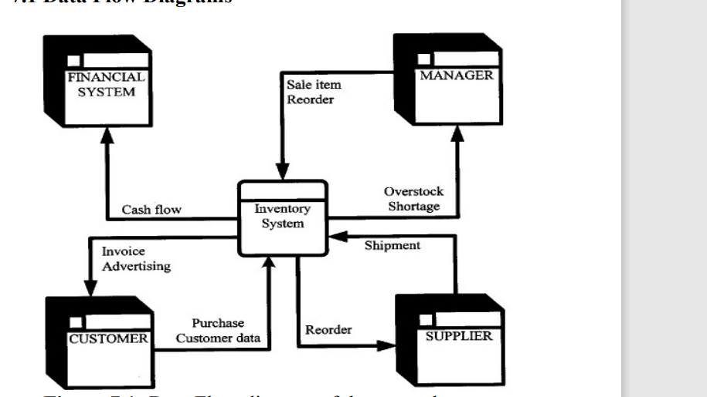

Slide 6
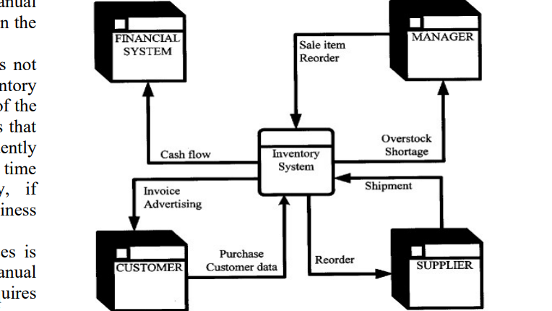
the complete inventory circle system, activities and processes the inventory system undergoes. We have five interconnected systems: which are the Customer, Financial System, Manager, Supplier and the Inventory system. In the Customer System an Advertised product is purchased by the Customer, the customer’s data is manually recorded at the inventory and invoice is issued in respect to the goods purchased. The Financial system records the transaction details and Cash Flows, the Manager of the company Records the Sale Item, checks the stock level to avoid Shortage and Overstock and issue an order if there is shortage of stock and the product supplied is not what was ordered, he will then Reorder for more. The Supplier of the product from the manufacturer checks the wholesaler’s order and Reorder and makes the Shipment or delivery of goods. Each stage and activities in the figure above takes manual inventory of the processes.

Slide 7
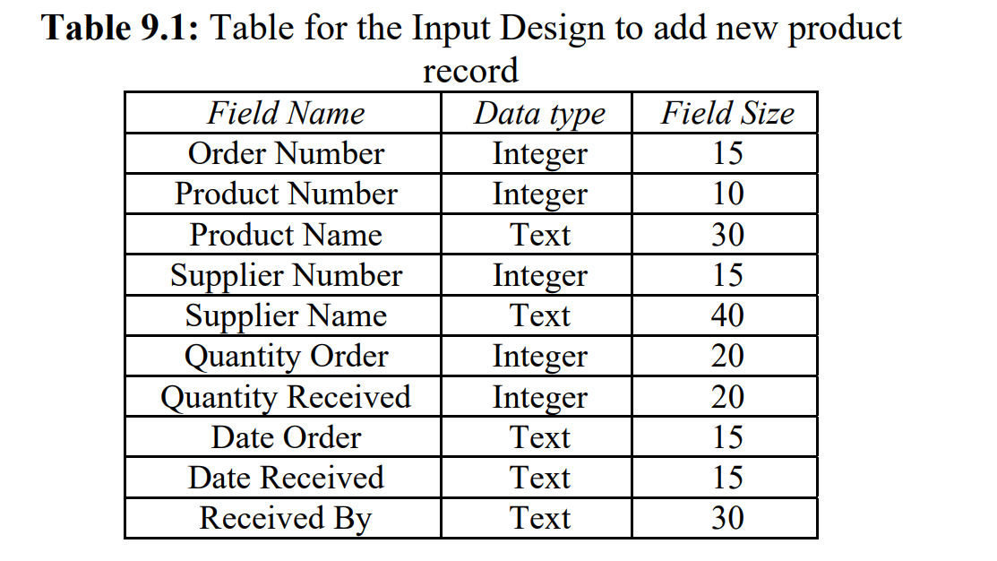
Data Analysis
9.1 Input Design
In any organization, institution or any system of operation there is always an input into the system which keeps a system going, if the input is wrong definitely the output will be wrong. This design is meant to handle data about a particular product or stock in the Supermarkets.

Slide 8
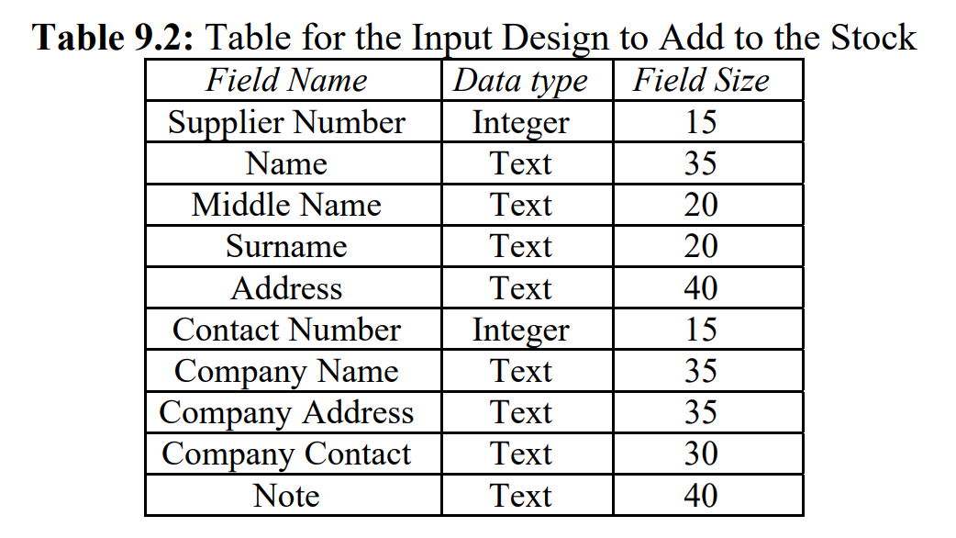
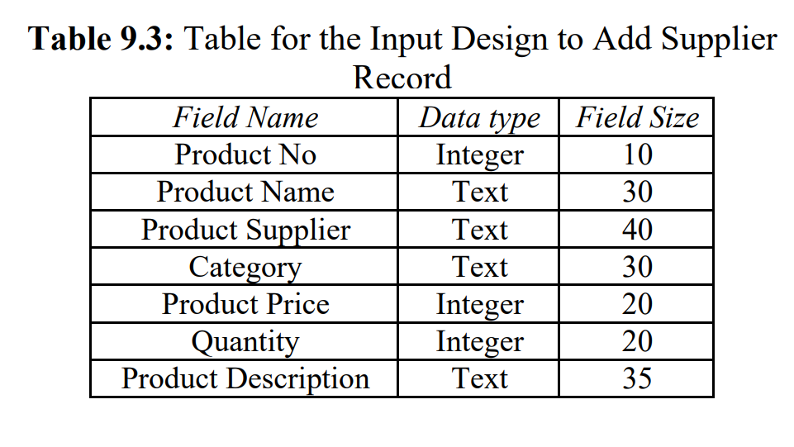

Slide 9
THANKYOU

